Slide 1
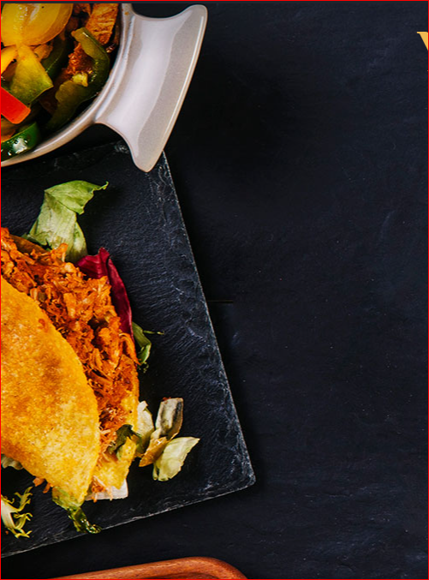
Catering Reservation And Ordering System

Slide 2
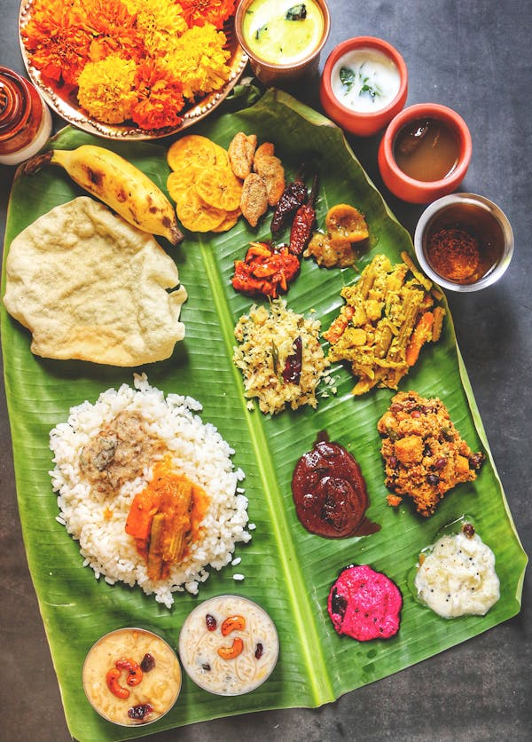
PROBLEM STATEMENT
Catering is a website that allows counter developers to promote and sell their catering. Rural towns would be able to sell their commodities to the rest of the globe as a result of this.
The goal of this project is to establish a portal that will allow users to buy catering from the admin and change product information securely using a mobile device. Catering is given priority in order to allow them to develop their skills and promote our traditional Indian culture.

Slide 3
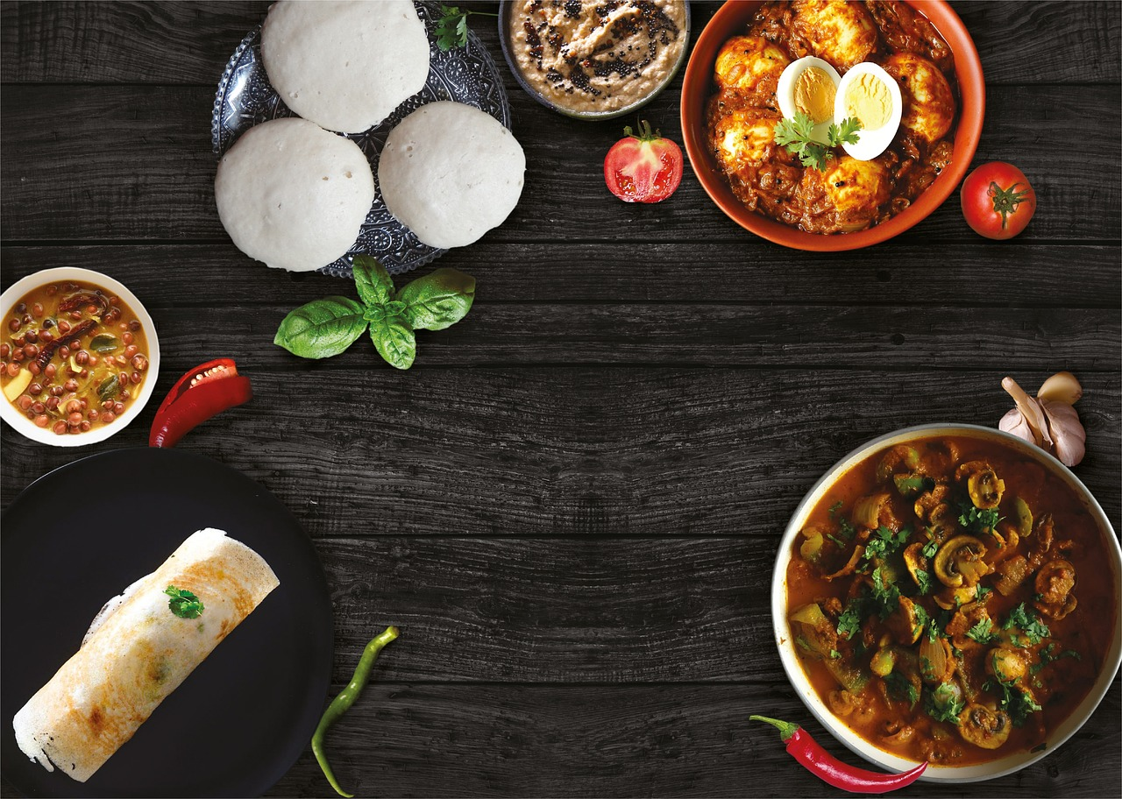
OBJECTIVE
The objective of an online ordering system are to provide user a convenient way to place orders over the internet and for caters to manage those orders.
An online ordering system allows customers to quickly and easily select items, add them to their cart, and submit their orders. For caters, an online ordering system provides a way to track orders and manage inventory more efficiently.
This system is developed for public users to view and order catering product. There are two main users in Catering Service management system, Administrator and Users. Administrator can maintain daily updates in the catering food and other records.

Slide 4

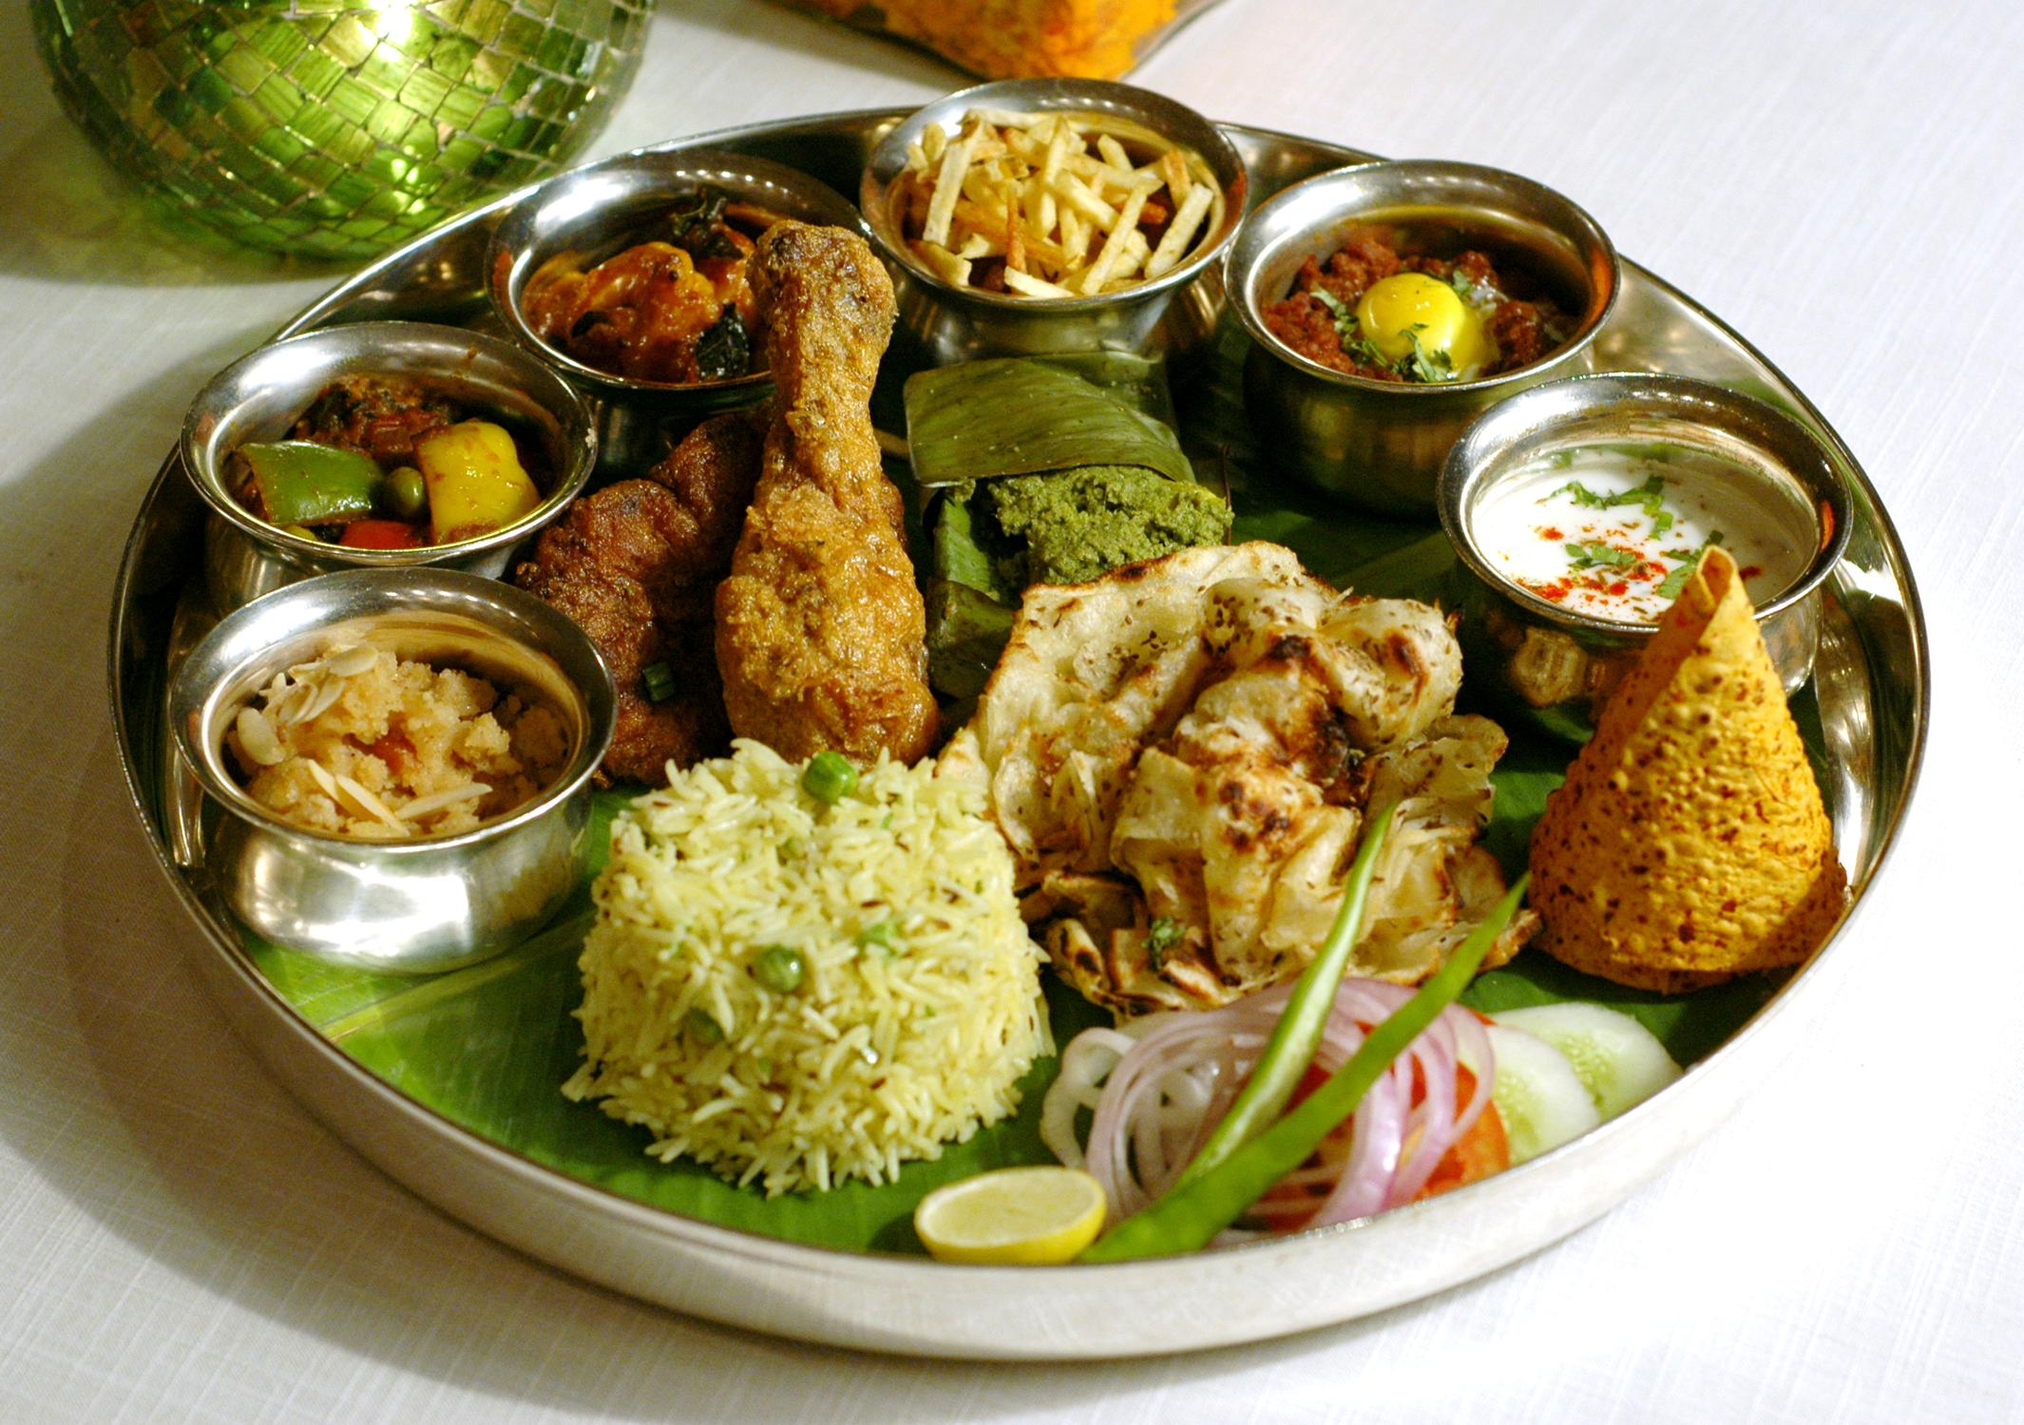
PROJECT MODULE
USER MODULE
REGISTER AND LOGIN
VIEW PRODUCT
ADD TO CART
MY ORDER
PLACE ORDER
MY PROFILE

Slide 5
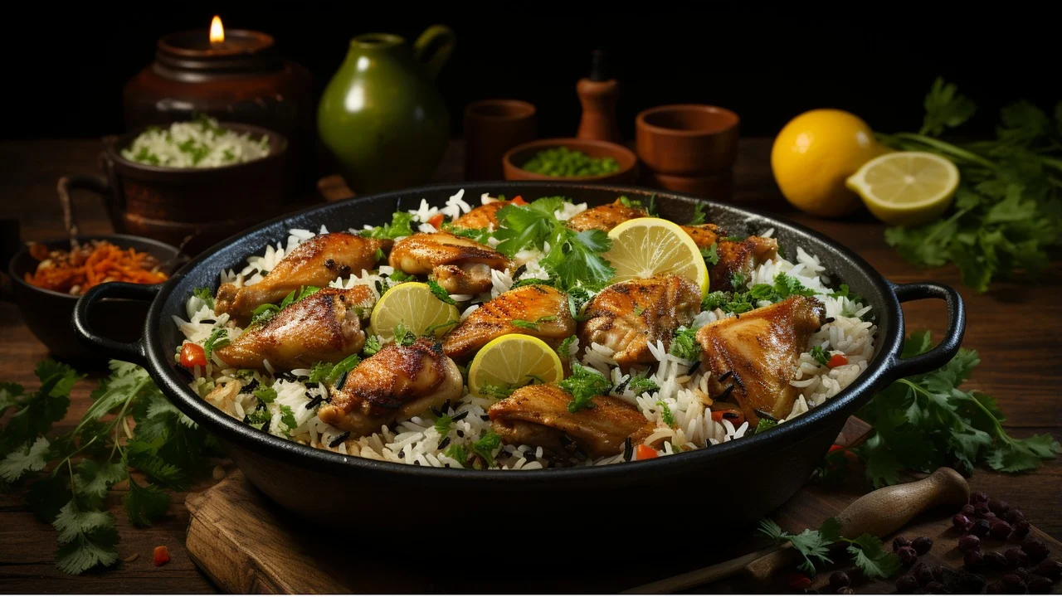
ADMIN MODULE
REGISTER AND LOGIN
UPLOAD PRODUCT DETAILS
VIEW ORDER

Slide 6
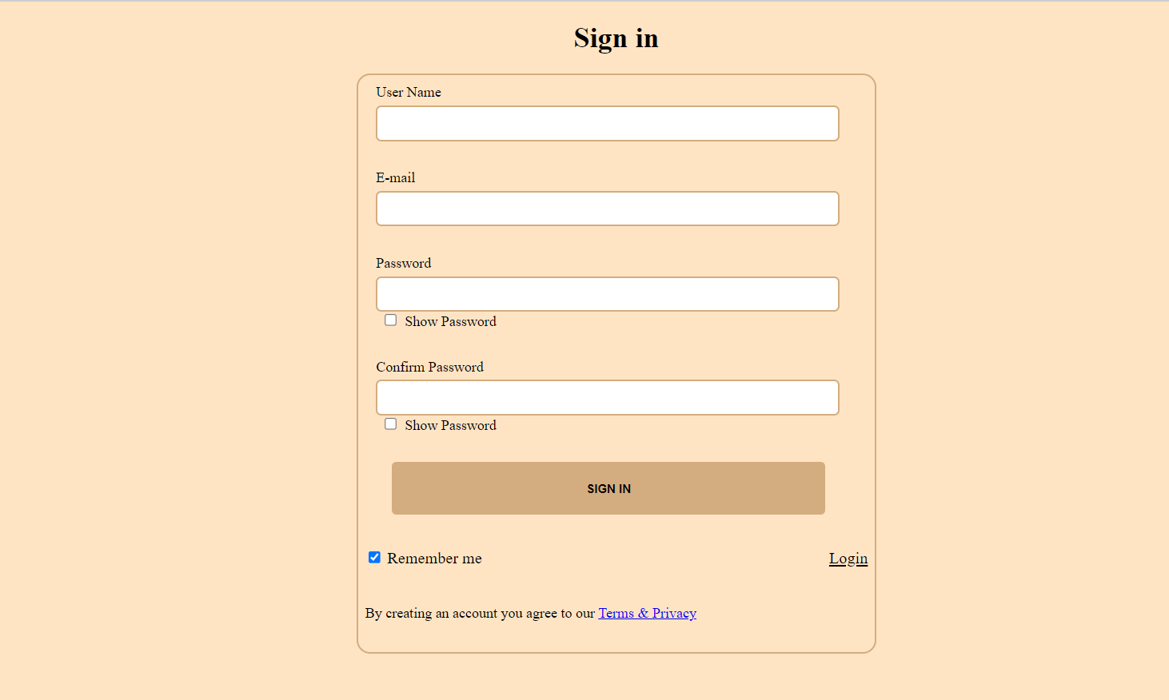
SIGN IN PAGE

Slide 7
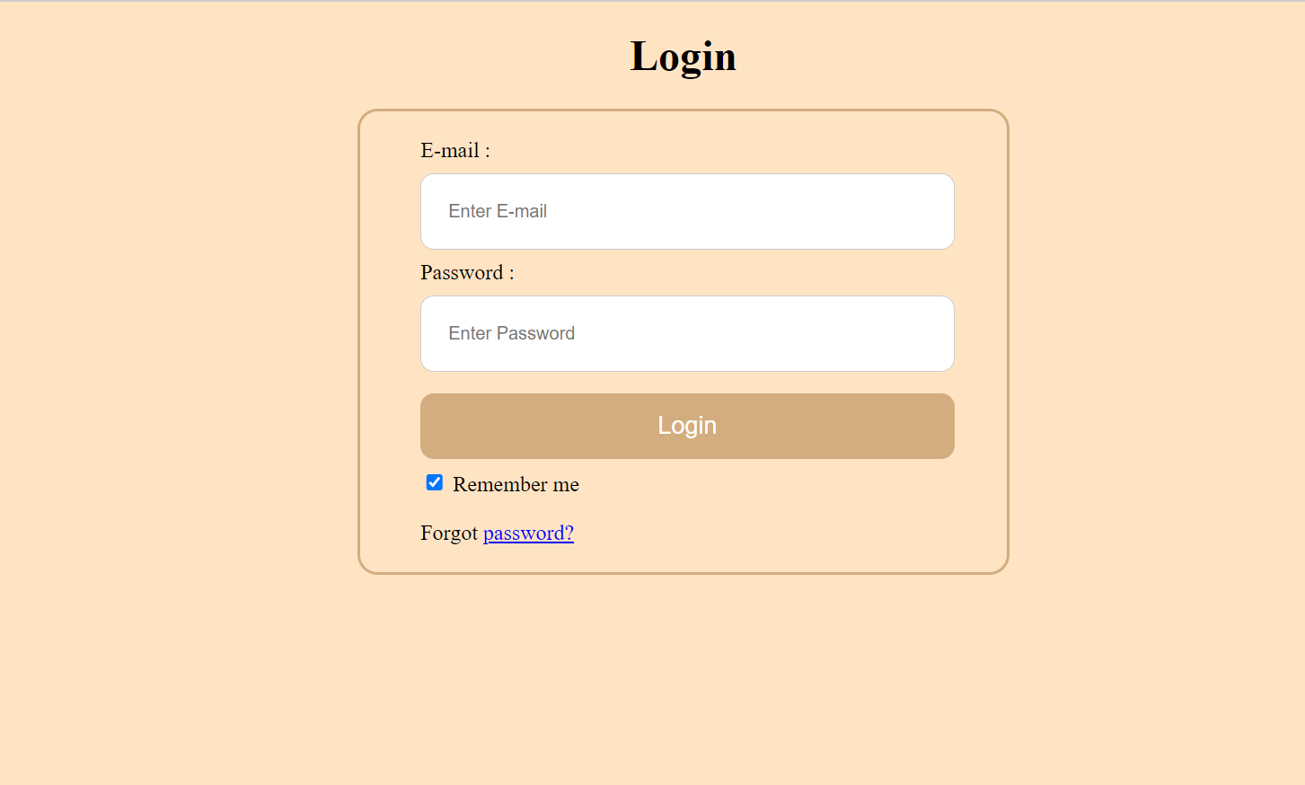
LOGIN PAGE

Slide 8
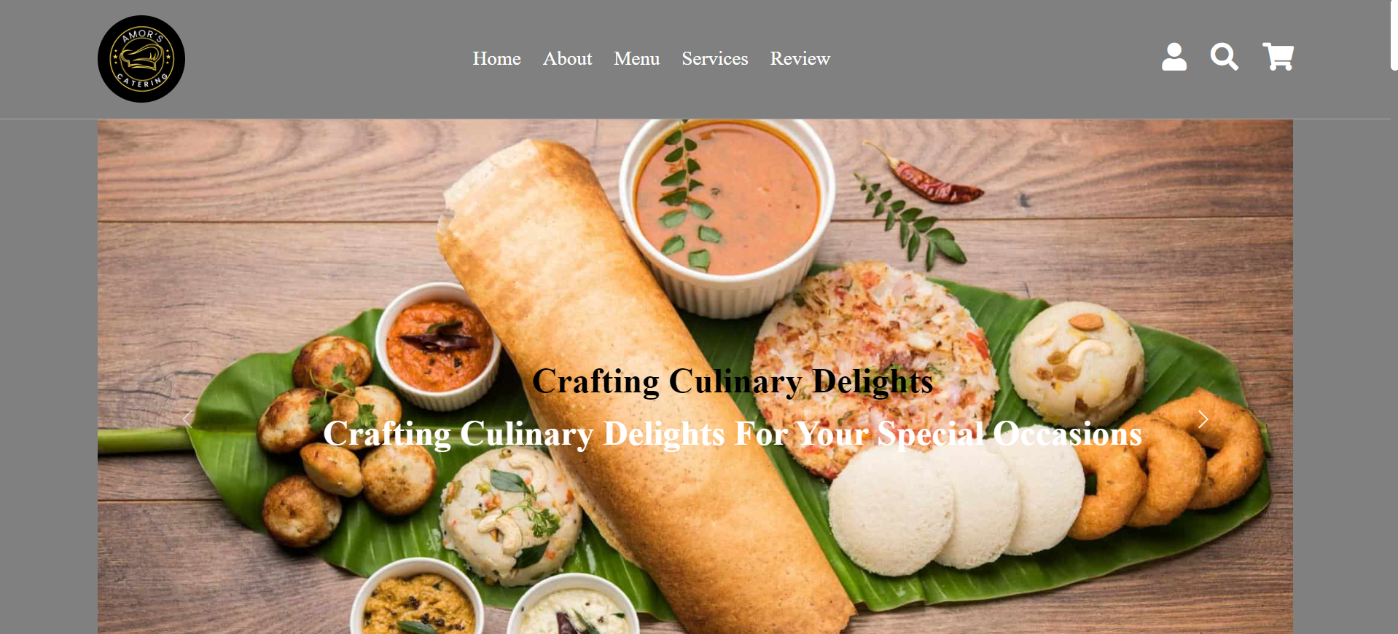
HOME PAGE

Slide 9
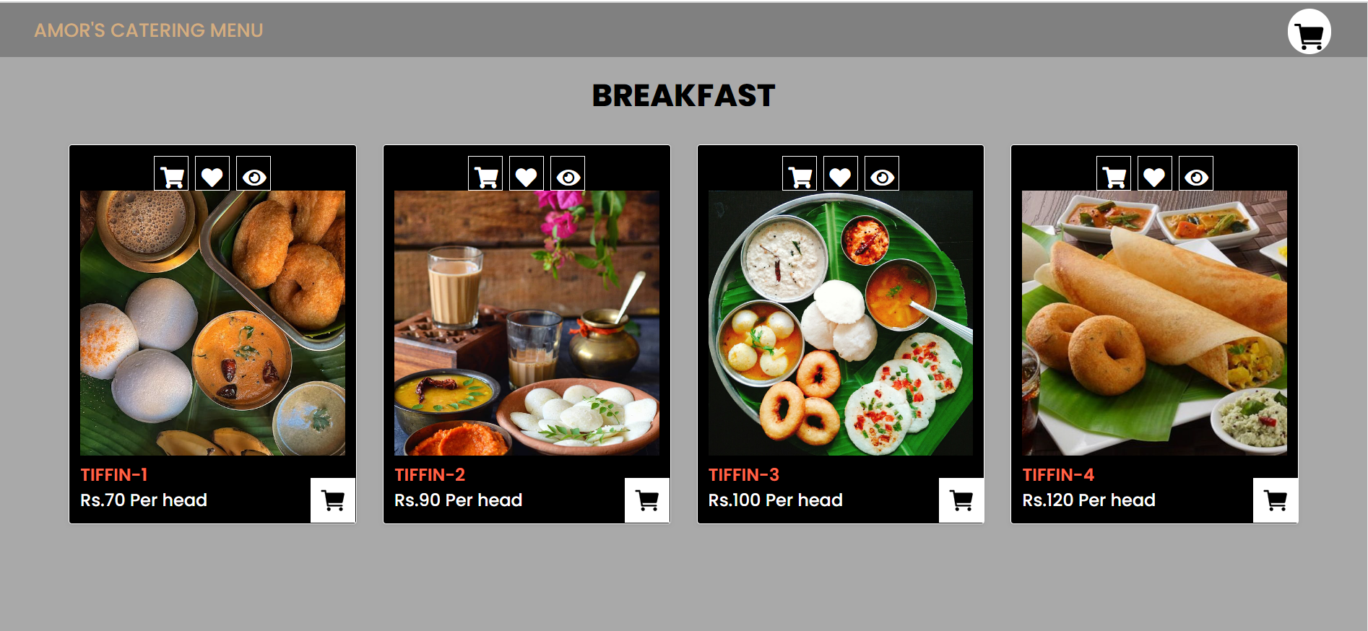
PRODUCT DETAILS

Slide 10
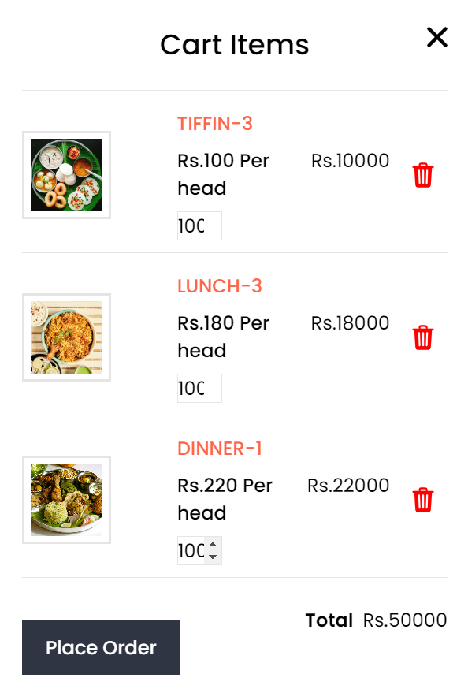
ADD TO CART

Slide 11
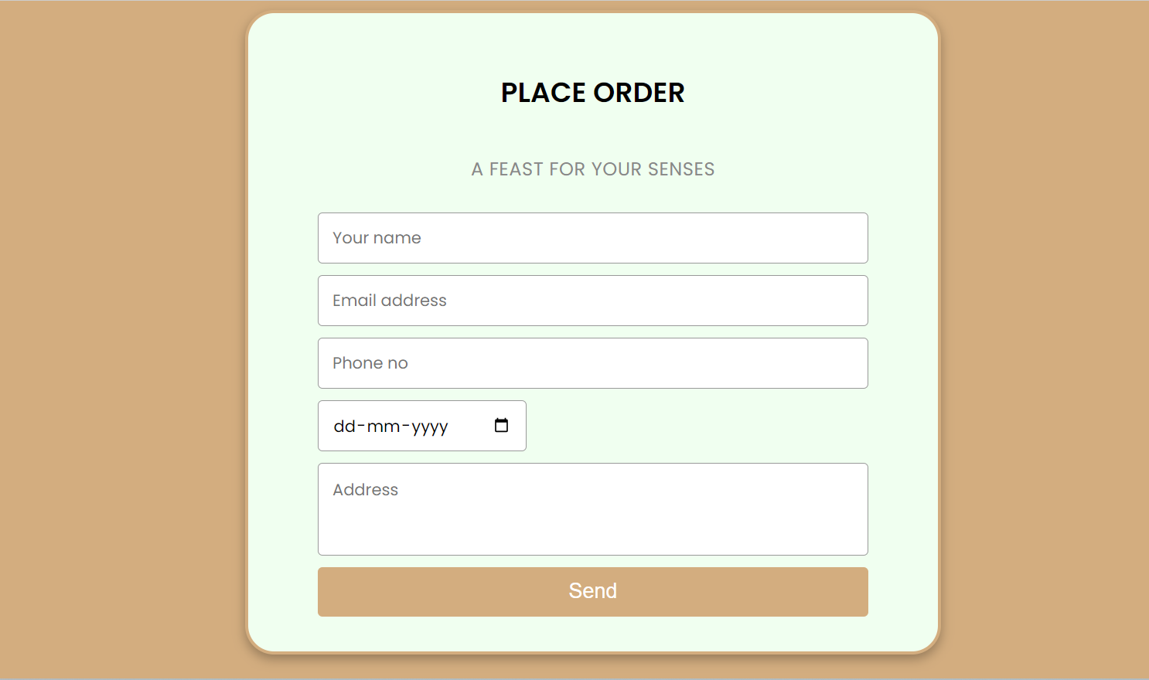
PLACE ORDER

Slide 12
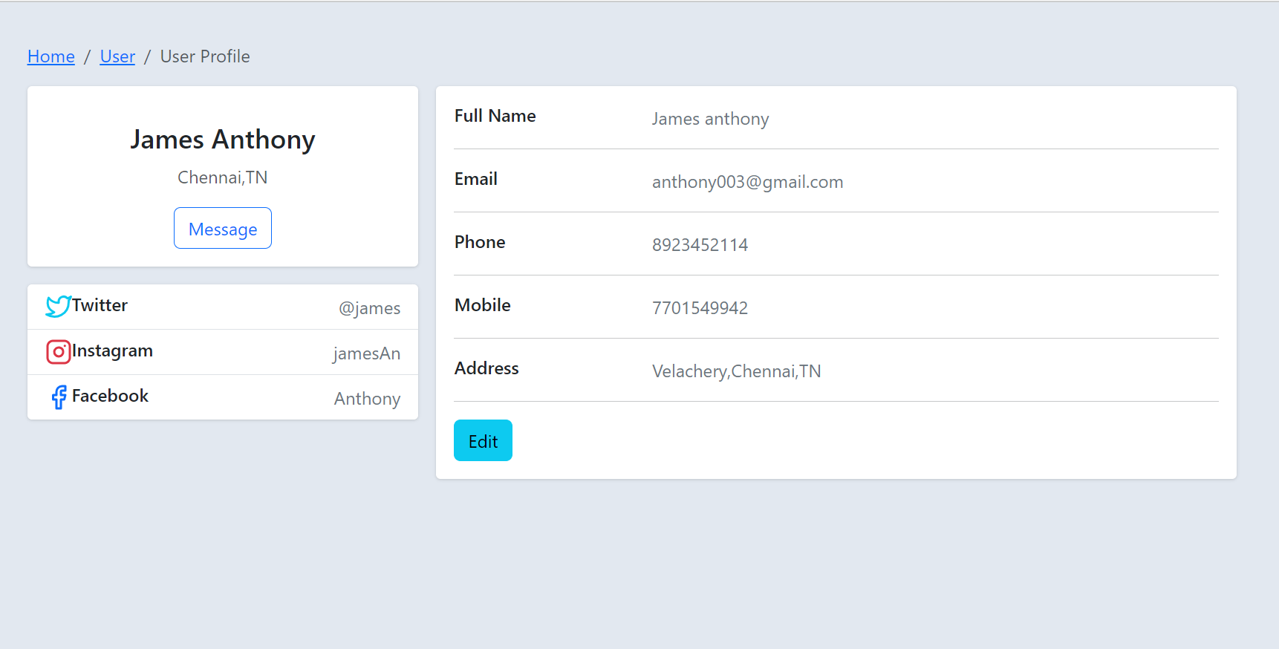
USER PROFILE

Slide 13
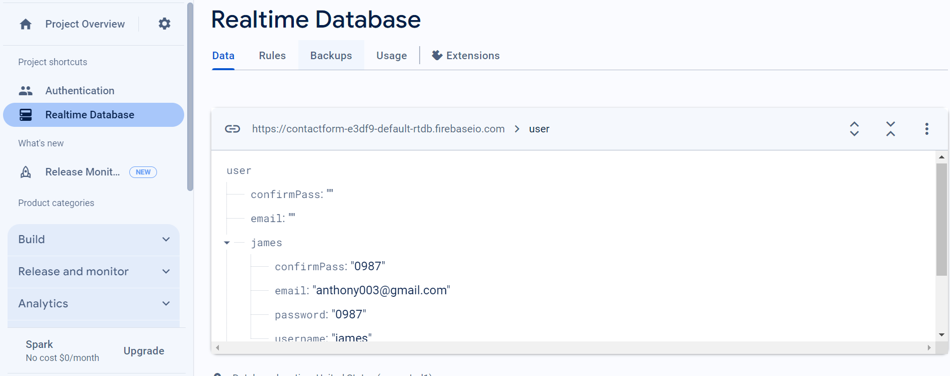
DATABASE

Slide 14

CONCLUSION
The Catering Reservation and Ordering System project is an implementation of a general Catering Booking website , which helps the customers to check product and prices of various catering menu , along with the different packages available with the reservations.
Javascript used for registeration and login process.
Firebase applied to save user sign in data.

Slide 15

THANK YOU

